Slide 1
Accessibility
Mr Mack 2022

Slide 2
Introduction
At this point in the curriculum you’ve learned incredibly valuable concepts in whichever full stack path you chose, you’ve created some awesome, resume worthy projects, and you should have a better understanding of some HTML and CSS concepts. One could even argue that you may now love working with CSS…?
What you may not have too much an understanding of, though, is the topic of accessibility, often referred to as “a11y” (due to there being 11 letters between the first and last letters). Unfortunately, this is a topic that many people either don’t know much about, or just don’t take into account when developing websites. If you fit into either of those two categories, you may have adopted some habits that aren’t exactly a11y friendly. Before we get into how you can break away from such habits and begin implementing a11y friendly concepts, it’s important to first understand some basic information about web accessibility.

Slide 3
Learning Outcomes
Explain what web accessibility is.

Slide 4
What is Web Accessibility?
Web accessibility means that websites, tools, and technologies are designed and developed so that people with disabilities and other circumstantial limitations can use them with as few barriers as possible.
There are different types of disabilities, including (but not limited to) auditory, physical/motor, cognitive, or visual. A disability can be permanent, such as a user who is completely blind or deaf, or it can be temporary, such as a user with a broken arm. Users can have multiple disabilities at any given time. Older users with changing abilities may even have similar conditions as those who have a disability.
Situational limitations are a little different. Using a phone outside on a bright day, browsing a site with one hand while you’re busy doing something else with the other, or living in an area where the internet is slow or the bandwidth is expensive are all examples of situational limitations. These limitations, unlike a disability, occur to users only in specific situations, but are still important to keep in mind when developing a website.

Slide 5
Why Web Accessibility Matters
Let’s first look at a non-web example to gain a little perspective. Imagine being in a multi-story building that has no elevator. For some people, this might only be an annoyance. “Huh, no elevator. I guess I’ll walk up a few flights of stairs, then.” A person that requires a wheelchair, however, would find it impossible, or at the very least much more difficult, to go anywhere beyond the first floor. Even if a person in a wheelchair had someone to lift the wheelchair up each step, it would be a much more difficult process. The point here is that an elevator would have made this building more accessible.
The building is your website, and the elevator is a collection of various accessibility features and tools (…it’s a pretty big elevator). When you develop a website, you’re developing it for users, and you need that website to actually be usable by them. People with disabilities, older people with changing abilities, people who aren’t as tech savvy, and people with some sort of situational limitation are still users, and websites should be as equally usable by them as possible.
One other pretty big reason that accessibility matters is that, depending on the country, there could actually be laws requiring accessibility to be implemented.

Slide 6
Read this
Go through Diverse Abilities and Barriers to get a better understanding of how some users with disabilities are affected by inaccessible sites.
Notes:
🍐 This is a Pear Deck Web Slide.
🍐 To edit the type of question, go back to the "Ask Students a Question" in the Pear Deck sidebar.

Slide 7
Watch this
Watch the videos on Web Accessibility Perspectives to see how (and which) users can benefit from accessibility features. Each video is pretty short and has audio descriptions and transcripts. If you prefer, the page also has a link to a compiled version of all of the videos on YouTube.
Notes:
🍐 This is a Pear Deck Web Slide.
🍐 To edit the type of question, go back to the "Ask Students a Question" in the Pear Deck sidebar.

Slide 8
Knowledge Check

Slide 9
What is web accessibility?
Notes:
🍐 This is a Pear Deck Text Slide
🍐 To edit the type of question, go back to the "Ask Students a Question" in the Pear Deck sidebar.

Slide 10
Who truly benefits from accessibility features?
Notes:
🍐 This is a Pear Deck Text Slide
🍐 To edit the type of question, go back to the "Ask Students a Question" in the Pear Deck sidebar.

Slide 11
Additional Resources
The Business Case for Digital Accessibility goes over reasons for implementing accessibility beyond just being more inclusive to more users.
How People with Disabilities Access Digital Content is a rather long video (a whopping 45 minutes), but it goes over a lot of various assistive technologies and will offer you some more perspective on how users with disabilities may browse the websites you create.
When we design for disability, we all benefit is a video featuring Elise Roy that furthers the point mentioned in this lesson, that accessibility benefits everyone. While this video is a more general overview that doesn’t revolve around web development specifically, it can still be an eye-opening experience.

Slide 12
The Web Content Accessibility Guidelines

Slide 13
Introduction
After the previous lesson, you should now have a better understanding of how important web accessibility can be for certain users, and how beneficial it can be for all users. But how do we know not only what should be a11y friendly, but how to make those things a11y friendly? Well, there are many sources available to tell us the what and how, those who actually rely on accessibility being one of the best sources we can consult.
Another source, one that goes over many different ways to help make websites more accessible, is the Web Content Accessibility Guidelines (WCAG). In this lesson we’re going to skim the surface of the WCAG, just to familiarize you with them at a more basic level.

Slide 14
Learning Outcomes
Explain the purpose of the Web Content Accessibility Guidelines.
Name the 4 principles of the WCAG.

Slide 15
Web Content Accessibility Guidelines
The WCAG exist in order to help create a shared standard when it comes to web accessibility. Think of web accessibility as the destination, and the WCAG as one of the tools that can help get us closer to it.
It’s important to understand that while the WCAG can be incredibly helpful for building an a11y foundation, they are not the finish line when it comes to accessibility. Like the name says, they are simply guidelines, and they will only help us make websites more accessible.

Slide 16
Four Principles
The WCAG are organized around four, core principles that should be kept in mind when implementing any sort of accessibility feature:

Slide 17
Perceivable
Users must be able to perceive the information or user interfaces being presented. Light text on a light background could be difficult for some users with a visual impairment to perceive, for example.

Slide 18
Operable
Users must be able to operate any user interfaces or navigation, and interfaces cannot require an interaction which the user cannot perform. A navigation bar with drop-down menus that only expand when a mouse cursor hovers over them, for example, would not be operable by keyboard users giving those menu items focus.

Slide 19
Understandable
Users must be able to understand any information or user interface that is presented to them. For example, if a user tried submitting a form and received an error such as “Error 113: Bad data”, they wouldn’t be able to understand what the error actually means or how to fix whatever caused the error.

Slide 20
Robust
Content must be accessible by current assistive technologies and other user agents, and must remain accessible as those technologies advance.

Slide 21
Conformance Levels
Conformance levels get mentioned at a couple of other points in these lessons, and we’re only mentioning them here to briefly explain what they are ahead of time. To put it simply, the WCAG has three different conformance levels, each of which is made up of various success criteria, or rules, that must be followed in order to successfully meet that level of conformance. You don’t need to worry about meeting any of these conformance levels completely for the purposes of these lessons, you only need to know that they exist (luckily their naming is pretty easy to remember).
Level A, or essential support, is the minimum level of conformance for the WCAG.
Level AA, or ideal support, is the level many organizations strive for. Meeting this level also requires meeting Level A.
Level AAA, or specialized support, isn’t recommended for entire sites to meet in full, as some content may make it impossible to meet this conformance level. Meeting this level would require also meeting both Level A and Level AA.

Slide 22
Before Implementing Accessibility
The lessons that follow dive into several concepts that can help you improve the accessibility of your websites, but they don’t cover every facet of accessibility. The goal of these lessons is just to introduce you to some of the more common or simpler concepts that you should get into the habit of checking for moving forward.
Even though we’re only introducing you to some of these a11y concepts, you may still worry that your site isn’t accessible enough. The first thing to keep in mind is that no site will ever be 100% accessible, so don’t try to aim for such an impossible goal. Sometimes the purpose or concept of a site even requires some things to not be accessible in certain ways.
The second thing to keep in mind is that just taking those first few steps towards creating accessible websites matters just as much as the many more steps you’ll take in the future. Even if you only add one a11y feature to your websites for now, what you may think is a minor addition could actually be a huge improvement for more users than you realize. So don’t feel like you have to make everything perfect or that you need to add everything at once when implementing accessibility, especially when you’re just starting out.

Slide 23
Read this
Read through the WCAG Overview page. Don’t worry about all of the other links for now. The goal of reading this page is to understand more of the included overview and to get familiar with the site itself for when you do need to visit other pages on it.

Slide 24
Skim this
Skim through WebAIM’s WCAG 2 Checklist, keeping in mind to read the important disclaimer. For now the goal is just to get an idea of common accessibility issues, some of which you’ll be ready to fix by the time you finish this set of lessons, rather than read through every issue listed on the page. Keep this resource bookmarked, though, as using it as your checklist when you start actively implementing accessibility will be really handy.

Slide 25
Knowledge Check

Slide 26
What is the purpose of the Web Content Accessibility Guidelines?
Notes:
🍐 This is a Pear Deck Text Slide
🍐 To edit the type of question, go back to the "Ask Students a Question" in the Pear Deck sidebar.

Slide 27
What are the 4 principles of the WCAG?
Notes:
🍐 This is a Pear Deck Text Slide
🍐 To edit the type of question, go back to the "Ask Students a Question" in the Pear Deck sidebar.

Slide 28
Semantic HTML

Slide 29
Introduction
As useful as <div> and <span> elements can be as generic containers, they’re not always the most a11y friendly elements to use. While it may be tempting or easier to just use them for everything, from containers to interactive areas, you should not only check whether there is a more appropriate element to use in certain situations, but also whether you’re using an element correctly.

Slide 30
Learning Outcomes
Explain why semantic HTML is important for accessibility.
Name the seven HTML elements that define landmarks on a page.

Slide 31
Importance of Semantics
In terms of web accessibility, using semantic HTML is important because it provides meaning and context. Some elements have a semantic meaning, but don’t really provide any context when announced by assistive technologies, such as the <p> element. Then there are elements that have a semantic meaning and are announced with some sort of context to help users perceive or operate them, like a <button>.
The <div> and <span> elements, most likely two of the more common elements you use, are semantically neutral. That is, they themselves have no semantic meaning and provide no context on their own to assistive technologies, which can make it more difficult for users of such technologies to perceive, operate, and understand them. Don’t let this lack of semantics and context make you feel like you can never use a <div> or <span> ever again, though. They still have their uses as generic containers, such as for layouts or for generic text.

Slide 32
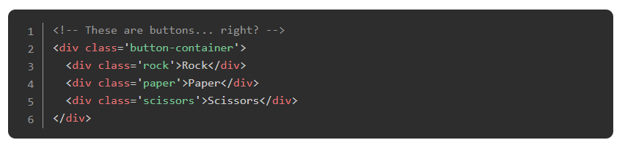
Importance of Semantics
Okay, let’s look at an actual example to help better understand this whole semantics and context thing. Think of any project you may have completed so far that required a user to click on something: Rock, Paper, Scissors; Calculator; Tic-Tac-Toe. If you used <div> or <span> elements for any clickable areas, things most likely worked as intended for you. For example, perhaps you had something similar to the HTML below for your Rock, Paper, Scissors UI back in Foundations:

Slide 33
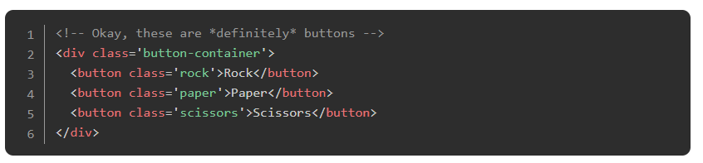
Importance of Semantics
A sighted user would most likely have no trouble playing the game if the elements looked like something to interact with. A screen reader user, however, would have no idea what any of these elements mean. The screen reader would announce the text contents of the element (“Rock”, “Paper”, or “Scissors”), and the user might think it’s just plain text on the page and move on. There’s no context to tell the user that they’re supposed to, or that they even can, interact with these elements.
This issue can be easily fixed by using semantic HTML:
Notes:
Because the <button> element has a semantic meaning and provides context, a screen reader would announce the text content as well as the role of the element: “Rock, button”.

Slide 34
Using Semantic HTML Correctly
When it comes to using semantic HTML correctly, you want to think about what your intent for users is and what context you want (or need) to provide to them. This can vary depending on the situation, but there are some things you should absolutely be checking for moving forward:
If a user is meant to click something, whether it’s an actual button or not, you will usually want to use a <button> element. This will let the user know that they can interact with the element by clicking on it.
If you want to provide some sort of tabular data to a user, use a <table> element along with the elements related to it. This will allow a user to more easily navigate and understand the data being presented.

Slide 35
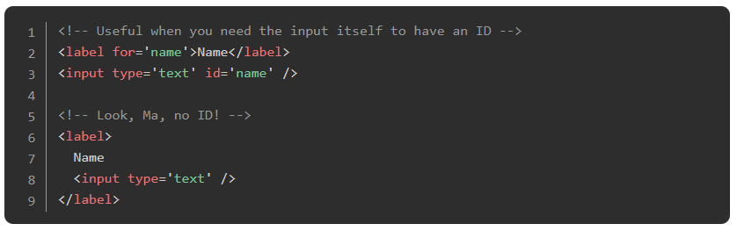
Using Semantic HTML Correctly
When you use an input element, you should always create a relationship between it and a <label> element. A <label> provides context for what an input actually means to assistive technologies, announcing the label contents each time the input is announced. Not only that, but a proper <label> increases the clickable area of the input itself, which is useful for users who have trouble clicking on smaller items. There are two ways you can create this relationship:

Slide 36
Using Semantic HTML Correctly
Continuing with inputs, you should always use the type that makes the most sense for its intended use. type="text"makes more sense for a name or address field, while type="email" or type="tel" would of course make more sense for an e-mail or telephone field, respectively. For certain devices, using the correct type may show only the required or additional characters on the keyboard. A type="tel" input, for example, might make it much easier for users to fill out their phone number by providing larger, numerical-only keys on mobile or tablet devices.
When you want to present a list of some sort to a user, you should use the appropriate list element (ol, <ul>, or <dl>) and their related list item elements. This will not only let the user know when they are entering or exiting a list, but also how many items are in the list.

Slide 37
Heading and Landmarks
Headings are the <h1> through <h6> elements, and like the name implies, these elements act as headings to sections of a page. Landmarks, on the other hand, are HTML elements that act as regions of a page. There are seven native HTML elements that define these landmark regions:
<aside>
<footer>
<form>
<header>
<main>
<nav>
<section>

Slide 38
Heading and Landmarks
By properly using landmarks and headings, you provide users of assistive technologies a more operable and understandbale page: not only can screen readers navigate a page via landmarks and headings by opening a menu in their screen reader, but these elements also have their roles announced to provide additional context.
If you were to use only <div> elements to act as these landmarks and headings, maybe adding in some CSS to visually style them, then a screen reader user would have to go through the entire page just to get to a specific section, and they may not be able to actually tell what is a heading or a landmark on the page.

Slide 39
Screen readers
Read How screen readers navigate data tables to see a great example of just how much context a proper <table> element provides. There is also a video at the end of the blog post if you want to hear how a table is announced.
Notes:
🍐 This is a Pear Deck Web Slide.
🍐 To edit the type of question, go back to the "Ask Students a Question" in the Pear Deck sidebar.

Slide 40
WHY???!!!
Watch Why headings and landmarks are so important to see how a screen reader interacts with the heading and landmark elements.
Notes:
🍐 This is a Pear Deck Web Slide.
🍐 To edit the type of question, go back to the "Ask Students a Question" in the Pear Deck sidebar.

Slide 41
Knowledge Check

Slide 42
Why is semantic HTML important for accessibility?
Notes:
🍐 This is a Pear Deck Text Slide
🍐 To edit the type of question, go back to the "Ask Students a Question" in the Pear Deck sidebar.

Slide 43
What are the seven HTML elements that define landmarks on a page?
Notes:
🍐 This is a Pear Deck Text Slide
🍐 To edit the type of question, go back to the "Ask Students a Question" in the Pear Deck sidebar.

Slide 44
Additional Resources
NVAccess provides a download of the NVDA screen reader, one of the more popular (and free!) screen readers available, though it’s only available for the Windows OS (this is the only time where we’re saying it’s okay to use Windows in the scope of this curriculum). If you’re using a macOS device, you should have the VoiceOver screen reader available to you by default. While the lessons in this section will provide you with what a screen reader will generally announce, it can be invaluable to start using a screen reader yourself to test out your projects and see how they might be perceived.
Screen Reader Basics: VoiceOver and Screen Reader Basics: NVDA go over some basics for getting started with both brands of screen readers. Both videos are worth watching regardless of which screen reader you choose/is available to you, as they contain some universal information as well.
ARIA Landmarks Example lists the native HTML elements that define landmark regions as well as what their role is. If you check this resource out, be sure to enable the button toggles at the top of the page to see how the page is sectioned by landmarks and how it uses headings.

Slide 45
Accessible Colors

Slide 46
Introduction
Although adding color to a page can make it more visually appealing, using the wrong color combination or relying solely on color to convey information can end up making things more difficult to perceive and understand for some users. This doesn’t mean you have to limit yourself when choosing color schemes for a website, but it does mean you have to take extra care when actually using those colors.

Slide 47
Learning Outcomes
Understand what a contrast ratio is.
Know how to check contrast ratios.
Understand why color alone should not be used to convey information.

Slide 48
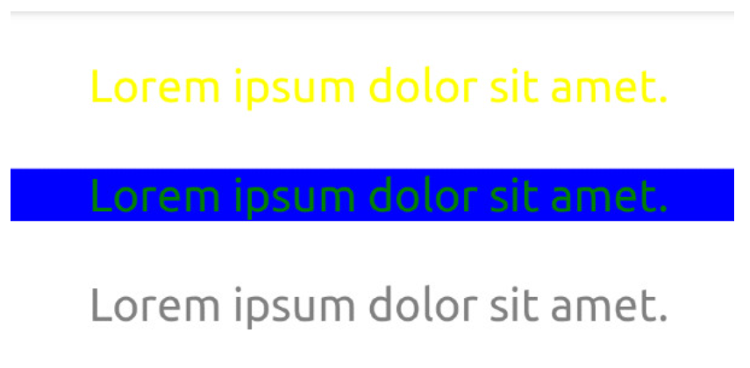
Color Contrast
Can you easily read the text in all three (yes, three) examples from the image above? If you can’t, then that’s because the contrast ratio is too low. If you can, then consider me jealous of your eye sight, but you still need to provide an easily perceivable website for visually impaired users.

Slide 49
Color Contrast
A contrast ratio is the difference in brightness between two colors expressed as a ratio. White text on a white background would have lowest ratio (1:1), while black text on a white background would have the highest (21:1). Contrast ratios refer to both normal text as well as images of text.
There are two different conformance levels for contrast ratios, both of which have rules for normal text and large text. Normal text is defined as text with a font size that’s less than 18 points/24px (or less than 14 points/18.66px for bold text), and large text is defined as text with a font size that is at least 18 points/24px (or at least 14 points/18.66px for bold text).

Slide 50
Color Contrast
Level AA (minimum) requires a contrast ratio of at least 4.5:1 for normal text and 3:1 for large text.
Level AAA (enhanced) requires a contrast ratio of at least 7:1 for normal text and 4.5:1 for large text.
Both conformance levels have exceptions that don’t need to follow the contrast ratio rules:
Incidental text, such as text that just happens to be within an image that has other significant visual content, or text that is purely decorative.
Text that is part of an inactive or disabled user interface component, such as a button that is disabled and has a lowered opacity.
Text that is part of a logo or brand name.

Slide 51
Color Contrast
At this point you might be thinking, “18.66 pixels? 4.5:1? How the heck am I supposed to remember these numbers? Wait, how am I supposed to calculate the ratios in the first place?!” Luckily for you, you don’t have to!
WebAIM Contrast Checker is a fantastic tool for checking contrast ratios. Just enter the HEX code of the foreground and background colors and it calculates what conformance levels, if any, the contrast ratio passes. The page also has a link for a link contrast checker, which goes over what the contrast ratio should be if a text link isn’t underlined.

Slide 52
Color Contrast
You can also check the contrast ratio of the text within an element using your browser’s dev tools. In Chrome, you would click the “element picker” tool in the Elements tab, then hover over an element on the web page. You can do the same thing in Firefox, except you have to click the “accessible object picker” tool in the Accessibility tab instead. For both browsers, if you select an element with text in the Inspector (Firefox) or Elements (Chrome) tab, you can click on the color picker tool for the “color” property under Styles to view the contrast ratio as well.

Slide 53
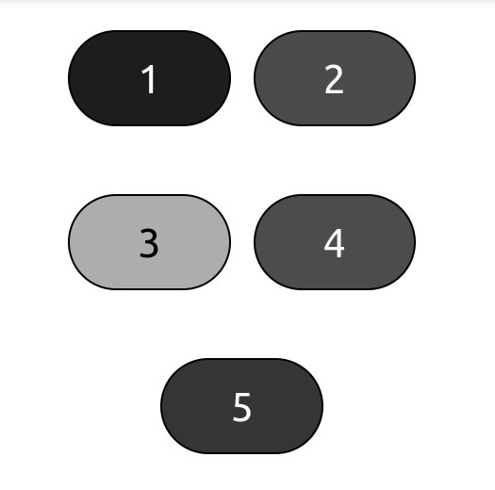
Conveying Information
Now that you know to take the contrast ratio into account when adding color for text and backgrounds, let’s see if you can tell which of the buttons in the image below is red:

Slide 54
Conveying Information
The answer, by the way, is button 4. The image above is simulating achromatopsia, which is also known as total color blindness. This illustrates a key point when using color: you shouldn’t use color alone to convey information. There may be exceptions where it’s necessary to only use color, but generally you want to follow this rule.

Slide 55
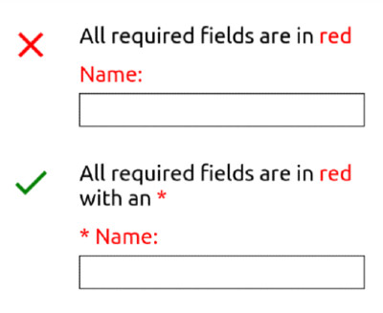
Conveying Information
Let’s look at another example. Let’s say you want to create a form that has an instruction stating that required fields are indicated by red text. If a user is color blind or otherwise has difficulty telling some colors apart, having to rely solely on the color of this text can make it difficult or even impossible to perceive or operate the form. Instead of only using color, your form could indicate all required fields with red text and an asterisk:

Slide 56
Knowledge Check

Slide 57
What is a contrast ratio?
Notes:
🍐 This is a Pear Deck Text Slide
🍐 To edit the type of question, go back to the "Ask Students a Question" in the Pear Deck sidebar.

Slide 58
What are two ways you can check a contrast ratio using your dev tools?
Notes:
🍐 This is a Pear Deck Text Slide
🍐 To edit the type of question, go back to the "Ask Students a Question" in the Pear Deck sidebar.

Slide 59
What should you avoid when conveying information to users?
Notes:
🍐 This is a Pear Deck Text Slide
🍐 To edit the type of question, go back to the "Ask Students a Question" in the Pear Deck sidebar.

Slide 60
Additional Resources
A Complete Guide to Dark Mode on the Web from CSS-Tricks can be a great starting point for implementing a dark theme for your website. It covers different ways you can toggle a theme, how to take into account a user’s preferred theme on their OS, and even saving a user’s preference. Although providing a light and dark theme can be a great accessibility feature for users (not just an aesthetic preference), it can take a lot of work to implement, hence why it is considered an additional resource.

Slide 61
KEYBOARD NAVIGATION

Slide 62
Introduction
Some users aren’t able to use a mouse to navigate or operate their computer, and by extension the websites they visit. These users may instead rely on using a keyboard or another assistive technology that can simulate keyboard inputs, such as voice recognition software. Other users may even just prefer using a keyboard over a mouse, or may use a mix of both. These users require proper keyboard navigation, something that can easily be overlooked when developing a website.

Slide 63
Learning Outcomes
Know the two things that interactive elements must have for keyboard users.
Understand what focus styles are and why you shouldn’t completely remove them.
Understand what the tab order is.
Know how to properly hide hidden content from assistive technologies.

Slide 64
Focus
Remember our Rock, Paper, Scissors example that didn’t use semantic HTML from the… well, Semantic HTML lesson? Another issue with using <div> and <span> elements is that, by default, they aren’t focusable and they don’t have any event handling by default. In order to fix our non-semantic Rock, Paper, Scissors example for keyboard users, we would need to take some extra steps, similar to the below code snippets:

Slide 65
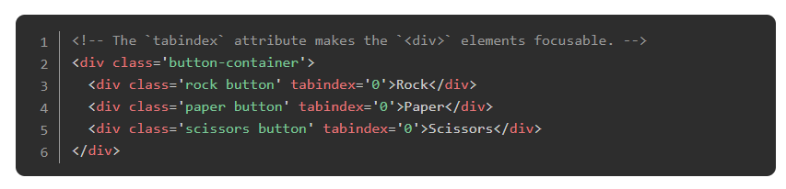
Focus

Slide 66
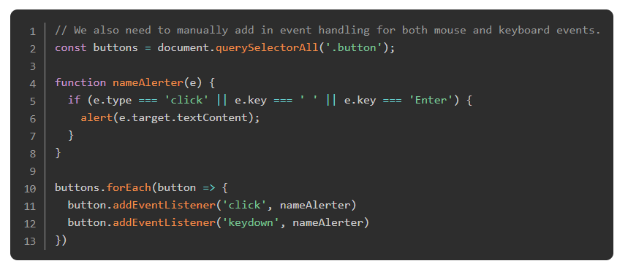
Focus

Slide 67
Focus
Of course, this example then makes it less understandable for screen reader users (remember, these “buttons” won’t provide any context). Not only does using the <button> element provide the context screen reader users need, but they’re focusable and have event handling for keyboards by default: pressing the “space” or “enter” keys on a keyboard when a <button> has focus will trigger the “click” event.
The point is that you need to make sure that any interactive elements are focusable by and have event handling for keyboards. Using the correct semantic HTML can make this a lot easier of a goal to accomplish, but if you ever need to use an element that isn’t focusable or doesn’t have any event handling by default, then you need to add both of those functionalities in manually.

Slide 68
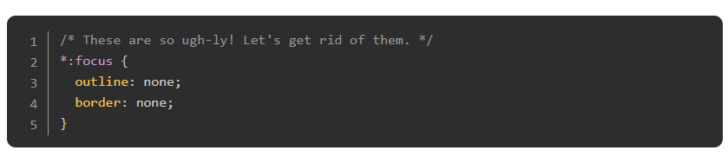
Focus Styles
Another aspect of focusable elements is their focus styles, which are usually an outline or border surrounding the element when it receives focus. One of the things you may have done, or may still do, is completely remove these focus styles by using CSS rules similar to the example below:

Slide 69
Focus Styles
You probably assume that you’re about to be told not to do this. Well… You should never completely remove focus styles. You should either leave these default focus styles alone, or you should replace them with your own focus styles. Whether it’s adding a transform: scale() CSS property to a button, adding an outline to a link, or increasing the border width and opacity on an input, adding your own focus styles is the only alternative you should consider to the default focus styles.
Why? Completely removing focus styles can make a page impossible for keyboard users to navigate and operate, as they have no visual indication what element actually has focus. It would force them to have to manually keep track of how many times they’ve pressed the Tab key while also trying to guess what elements are actually focusable. Imagine trying to browse a website with an invisible cursor and without any visual indication of when the cursor was hovering over interactive elements like links or buttons. Doesn’t sound too fun, does it?

Slide 70
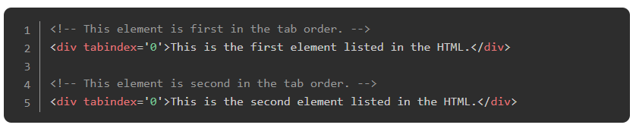
Tab Order
The tab order is the order in which elements on the page will receive focus when pressing the Tab key, and is by default in the same order as the order of elements listed in the HTML file:

Slide 71
Tab Order
Sometimes you may find it necessary to either change the visual order of elements on a page using CSS (the float or order properties, for example), or the tab order of elements themselves using the tabindex attribute. Regardless of which method you may use, you should make sure the tab order matches the visual order of elements. If the tab order is different from the visual order, users could be left confused or frustrated trying to navigate the page with a keyboard, expecting one element to receive focus based on the visual layout and instead another element receives focus.
The best way to avoid this issue is to just place elements in your HTMl file in the order that you want them to actually receive focus.

Slide 72
Hidden Content
Sometimes you may want to hide some content until a specific event occurs, such as a user clicking on a button to open a menu or a modal box. When you want to hide content for this sort of purpose, you need to make sure the content is not only visually hidden, but also hidden from assistive technologies until that content is meant to be visible.
If you don’t properly hide such content, then keyboard users would be able to tab into that content before they’re meant to, but in doing so they would lose track of any visual focus on the page. These users would be left confused or even frustrated when they’re trying to tab through a page, only for their focus indicator to disappear into that hidden content.

Slide 73
Hidden Content
One way to prevent this frustrating behavior is to give each individual item in that hidden content a tabindex value of -1, since that prevents an element from receiving focus via the keyboard (though you can still give it focus with JavaScript’s focus() method). While this fixes the issue for keyboard users, other assistive technologies would still have access to and could still announce this hidden content.
A better solution is giving the container for the hidden content itself either the display: none or visibility: hidden CSS property when it’s hidden, and removing or overriding that property when it’s meant to be visible. This not only removes the menu items from the tab order, but it also prevents assistive technologies from announcing them.

Slide 74
Watch This
Watch What is Focus? to see some issues that occur when trying to change the tab order, then watch Controlling focus with tabindex to see how using the tabindex attribute can affect the tab order.

Slide 75
Knowledge Check

Slide 76
What are two things that interactive elements must have for keyboard users?
Notes:
🍐 This is a Pear Deck Text Slide
🍐 To edit the type of question, go back to the "Ask Students a Question" in the Pear Deck sidebar.

Slide 77
Why should you never completely remove focus styles from an element?
Notes:
🍐 This is a Pear Deck Text Slide
🍐 To edit the type of question, go back to the "Ask Students a Question" in the Pear Deck sidebar.

Slide 78
What is the tab order?
Notes:
🍐 This is a Pear Deck Text Slide
🍐 To edit the type of question, go back to the "Ask Students a Question" in the Pear Deck sidebar.

Slide 79
What is the best way to hide hidden content from assistive technologies?

Slide 80
Additional Resources
Skip Links are another form of accessibility for keyboard users and can be especially helpful for those who require more effort to tab through the contents of a page.

Slide 81
Meaningful Text

Slide 82
Introduction
Meaningful text is pretty straight forward: when a user reads text or has it announced to them, they should be able to immediately understand what it means even without any surrounding context. A lack of meaningful text can affect all users, but especially those who rely on assistive technologies. In this lesson we’ll be going over a few instances where you should start making sure you provide meaningful text to users.

Slide 83
Learning Outcomes
Know how to provide meaningful links.
Know how to provide meaningful text in forms.
Know how to provide meaningful alt attributes for images.

Slide 84
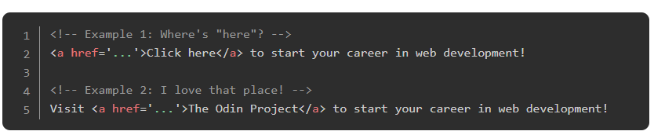
Links
Let’s take a look at two different examples of a link:

Slide 85
Links
To a sighted user, the link in Example 1 makes perfect sense. However, in addition to being able to navigate a page via landmarks and headings (as mentioned in the Semantic HTML lesson), a screen reader may be able to navigate between each element of a specific type, such as links. If a user were to navigate between all of the links on a page, the only thing that would get announced in Example 1 is, “Click here, link.” Where’s “here” exactly? Without any surrounding context, the link is meaningless. Not only that, but if you have multiple links on a page with that same text content, then users will be told to “click here” many times.
The link in Example 2, however, not only makes sense in context for all users, but it also makes sense out of context for screen reader users when it gets announced: “The Odin Project, link.”

Slide 86
Links
When you add links to a page, there are a few rules you should be following:
Make sure that the text content of the <a> element somehow indicates where the link redirects to and that it’s brief (around 100 characters). So avoid using phrases like “click here” or “this page”.
If a link would open or download a file, include text that tells the user what kind of file it is as well as the file size.
If a link would automatically open in a new tab or window with the target="_blank" attribute, you should indicate this to the user in some way.

Slide 87
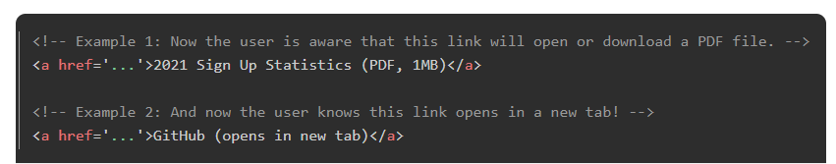
Links
The next time you need to use links, try saying the contents of the element out loud to yourself. Does it reasonably indicate where that link would take you, such as the title of the page, article, or video? Are you aware whether it’ll open in a new tab automatically or not, or that it’ll open a download dialog? If you’ve been testing out using a screen reader up to this point, then an even better way to test whether a link has meaningful text is with the screen reader itself!

Slide 88
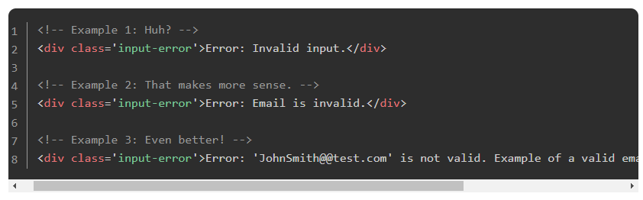
Forms
Providing meaningful errors to users when they are filling out or submitting a form can turn the experience from frustrating to… well, maybe not fun, but at the very least just a bit less frustrating. Let’s take a look at a few error examples, ranging from not helpful at all to very helpful:

Slide 89
Forms
Even if you could tell what input caused the error in Example 1, which may not always be the case, the error doesn’t provide any meaningful text. What input is invalid? Why is it invalid? How can you fix it? None of these questions are answered. Now imagine how meaningless this error must be to users of assistive technologies, who may not be able to see where an error is rendered on the page and may only have “invalid input” announced to them.
The error in Example 2 clearly tells you what input is invalid, so you now know exactly where to go. While this might be all a user needs to know, it’s worth keeping in mind that it is still a rather vague error. We don’t know why our email is invalid.

Slide 90
Forms
The error in Example 3 is even more meaningful. It not only tells you what input is invalid, but also how to fix the error. Generally when you inform a user of a form error, you should be informing them what input caused the error and, when possible, how to fix the error or why the error occurred in some way.
Another way to provide meaningful text in forms is with instructions, such as when a password input lists any characters that the password must contain (“Must include at least one uppercase letter and one number…”). For instructions that are unique to an input, they should be placed alongside the input itself. Instructions that are more global across the form, such as indicating which inputs are required, should either be placed at the top of the form (“* indicates a required field”), or placed alongside the input or its label (“Name (required)”).

Slide 91
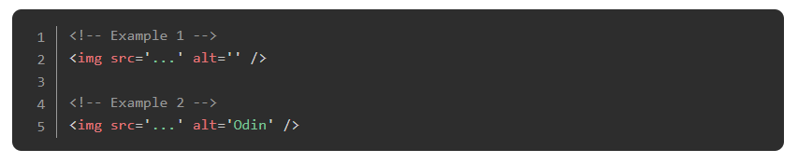
Alternate Text
At this point you should be pretty familiar with the alt attribute on img elements. Whether you are or not, let’s see if you can tell which of the following examples is valid:

Slide 92
Alternate Text
Believe it or not, both examples above are valid! While Example 1 doesn’t actually have any meaningful text (perhaps a meaningful lack of text), you should still understand its importance. When you’re using an image purely for decoration, or the image just isn’t really important for the user to be aware of, you generally don’t want users of assistive technologies to be made aware of it. In those cases, you should always use an empty string for the value of the alt attribute as seen in Example 1 (this is also known as a null value, not to be confused with the JavaScript data type). If you simply omitted the alt attribute, the presence of the image could still be announced, which may confuse the user (especially if the file name was a random string of letters and numbers).
For Example 2, the screen reader would announce, “Odin, graphic”, making the user aware that there’s an image and what it’s an image of. What the alternative text should be for an image will ultimately depend on various factors, though. Read Alternative Text - WebAIM to learn about when and how you should be adding alternative text for images based on the function of the image and the context surrounding it.

Slide 93
Knowledge Check

Slide 94
What are three rules you should follow in order to provide meaningful links?
Notes:
🍐 This is a Pear Deck Text Slide
🍐 To edit the type of question, go back to the "Ask Students a Question" in the Pear Deck sidebar.

Slide 95
What information should you inform users of in order to provide meaningful error messages in forms?
Notes:
🍐 This is a Pear Deck Text Slide
🍐 To edit the type of question, go back to the "Ask Students a Question" in the Pear Deck sidebar.

Slide 96
When should you use the empty string/null value for the alt attribute?
Notes:
🍐 This is a Pear Deck Text Slide
🍐 To edit the type of question, go back to the "Ask Students a Question" in the Pear Deck sidebar.

Slide 97
Additional Resources
Making Accessible Links: 15 Golden Rules For Developers is a little old, but is still a great list of 15 rules for creating, well, accessible links. Some of the rules the article goes over were mentioned in this lesson, but there are some other rules that can help make sure you’re creating a11y friendly links.
Usable and Accessible Form Validation and Error Recovery goes over a few different ways you can provide errors to users (using the alert in JavaScript, providing all errors at the top of the page, and using inline errors), as well as the pros and cons of each.

Slide 98
ACCESSIBILITY AUDITING

Slide 99
Introduction
By now you should feel confident enough to start making your websites a little more accessible for a lot of users. What can really help you make sure you’re implementing certain a11y features correctly, though, is learning how to view the accessibility tree in your DevTools and how to audit your web pages for any outstanding a11y issues.

Slide 100
Learning Outcomes
Open the accessibility section within your browser’s DevTools.
Audit a web page with a third party auditing tool.

Slide 101
Accessibility DevTools
Using your browser’s DevTools is beyond useful for several things, from checking the styles applied to a page to debugging code, but you already know that! Here’s something you may not know: you can even use the DevTools to look at various accessibility features as well, which can be great as a sort of “quick audit”. You can check contrast ratios (as we mentioned in a previous lesson), view various accessibility properties, and view the accessibility tree, to name a few features.

Slide 102
Accessibility Auditing
There are plenty of third party tools to audit the accessibility of a web page, each with their own pros and cons, though we’re only going to mention three of those tools here. By getting into the habit of auditing your web pages, you’ll be able to track down any outstanding a11y issues that you may have missed. If you decide to utilize one of these tools, or another auditing tool if you prefer one you come across, you should focus on fixing issues related to the concepts introduced in these lessons only for now.

Slide 103
Accessibility Auditing
axe DevTools for Chrome is an extension-based tool that returns a list of issues ranked by severity level, and will note any issues for you to manually check.

Slide 104
Accessibility Auditing
Lighthouse for Chrome is available in the Chrome DevTools by default (it might also be listed as the Auditing tab) or it can be ran from the command line. Lighthouse provides more than just a11y auditing, including performance, best practices, search engine optimization (SEO), and progressive web app (PWA) if applicable. Any issues will be separated by category, and like the axe DevTools there may be a list of issues for you to manually check.

Slide 105
Accessibility Auditing
WebAIM’s WAVE is a website based tool where you enter the URL of the page you want to audit, though there are also browser extension and API options. WAVE will return a preview of the page with an overlay of icons on it, and issues are separated into categories of alerts, warnings, and contrast errors. Unfortunately the icons that are placed on the page may cause the layout to break, but that could be a minor issue if you’re more focused on the a11y issues that are found.
Notes:
Of course, one of the best ways to check the accessibility of your websites is to get feedback from users who rely on these accessibility features. Obviously this isn’t always an easy option, but when you can it will be worth hearing from those who may be affected by your site’s accessibility (or lack of it).

Slide 106
Read
Accessibility features reference, starting from the Accessibility pane section, provides a brief overview of Chrome’s accessibility features in the DevTools.

Slide 107
Additional Resources
Involving Users in Evaluating Web Accessibility goes over some helpful steps to take when you can get feedback from users.
The WCAG Quick Reference provides a list of success criteria along with techniques for how to satisfy them and links to understanding them in more detail. This tool is a great go-to when you’re really ready to push your website to the next accessible level. If you often use animations, success criterion 2.2.2 (“Play, Stop, Hide”) and all of the 2.3 success criteria are definitely worth reading.
A11ycasts Playlist. We’ve included several videos from this playlist in these lessons, but there are other videos worth checking out for various accessibility topics.
screenreader-outputs is a GitHub repo that contains many examples of screen reader outputs. Sometimes nested elements or certain combinations of attributes and native labeling may result in accessible names or descriptions that are difficult to make sense of, so checking out this repo may help clear things up.

